Slide 1
Course Allocation
INFO 4220 – Networks II: Market Design
Adapted from Haeringer Ch.16

Slide 2
Assignment Models
The assignment problems we have seen so far are either:
  One-to-one: Tenant problem
  Many-to-one: School choice
For these problems we can choose algorithm that have certain properties: Strategyproof, efficient, or stable
We will now look into many-to-many assignment problems
  Much more complicated
  Course allocation: Each student chooses multiple courses, each course enroll multiple students

Slide 3
Definition
A course allocation problem is given by:
A (finite) set of students
A (finite) set of courses
Students must be assigned a schedule: A collection of courses
Courses can enroll multiple students
A course allocation problem is a special case of a combinatorial assignment problem

Slide 4
Cornell’s course enrollment (SP25)
Jan 14: Add-Drop Begins: Graduate/Professional Students + Seniors
Jan 15: Add-Drop Begins: Juniors
Jan 16: Add-Drop Begins: Sophomores
Jan 17: Add-Drop Begins: First-years
Is it strategyproof?
Does this resemble any mechanism we have seen?
What would you say is the closest?
What could be improved?

Slide 5
Preferences in Course Allocation
In a course allocation problem students have preferences over schedules
We had been assuming in many-to-one problems that preferences are responsive. We cannot make this assumption so lightly here:
  Some courses are complements
  Some courses are substitutes
Responsive preferences do not allow us to capture such realistic constraints
We will see what can be done with responsive preferences, but, ultimately, we will have to drop the assumption

Slide 6
Choosing an Assignment Mechanism
There are not many choices when it comes to choosing an assignment mechanism
We need to define one concept before proceeding
Non-bossiness:
A mechanism assigns courses to students using their preferences
Bruno modifies his submitted preference list, but this change does not affect Bruno’s schedule
If the mechanism is non-bossy: Bruno’s change to his submitted preferences doesn’t affect anyone else’s schedule

Slide 7
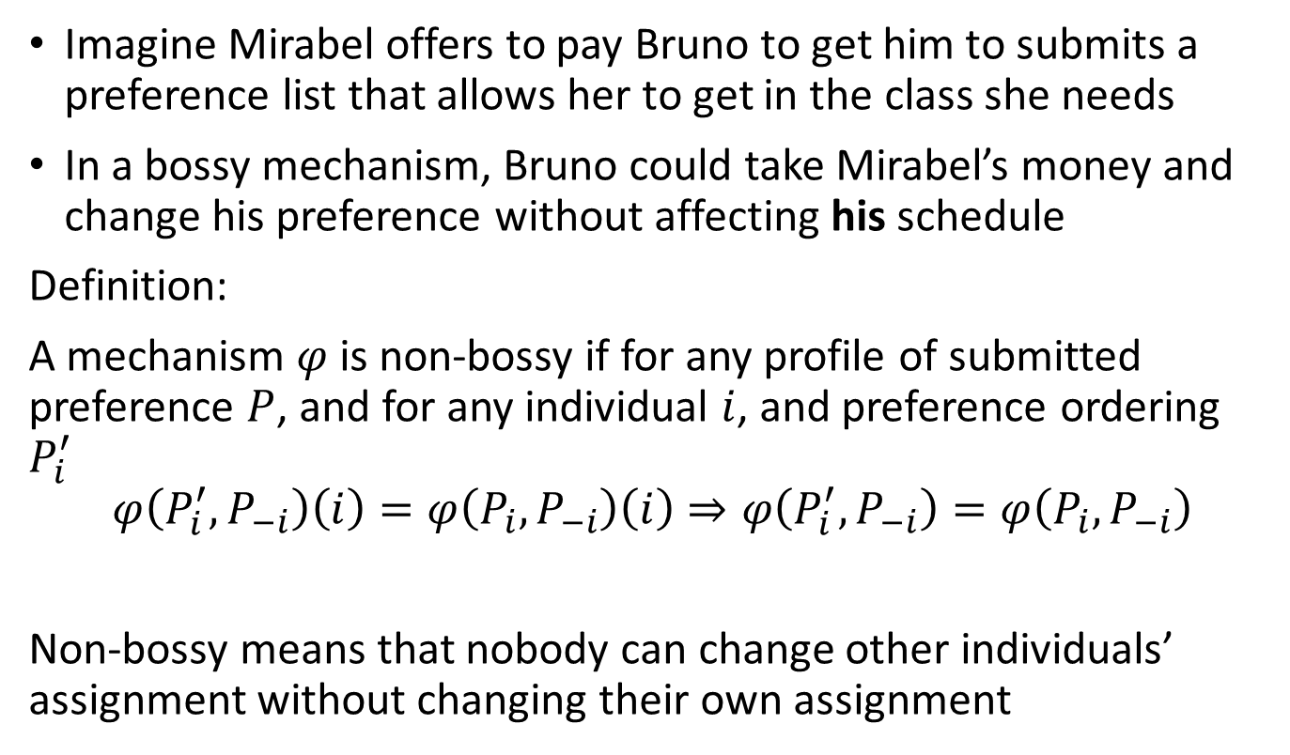
Choosing an Assignment Mechanism
Imagine Mirabel offers to pay Bruno to get him to submits a preference list that allows her to get in the class she needs
In a bossy mechanism, Bruno could take Mirabel’s money and change his preference without affecting his schedule
Definition:
A mechanism $φ$ is non-bossy if for any profile of submitted preference $P$, and for any individual $i$, and preference ordering $P_{i}^{′}$
$$φ\left(P_{i}^{′},P_{−i}\right)\left(i\right)=φ\left(P_{i},P_{−i}\right)\left(i\right)⇒φ\left(P_{i}^{′},P_{−i}\right)=φ\left(P_{i},P_{−i}\right)$$
Non-bossy means that nobody can change other individuals’ assignment without changing their own assignment
Preferences of everyone but i
i’s assignment
Everyone’s assignment

Slide 8
Serial Dictatorship in Course Assignment
Theorem (Pápai):
A many-to-many assignment mechanism is strategyproof, non-bossy, and pareto efficient if, and only if, it is a serial dictatorship mechanism
Does this mean we are done for today?
Not quite. Because we will see that students don’t like the outcomes of using a serial dictatorship mechanism much

Slide 9
Bidding for Courses
A common assignment mechanism used at many school is running an auction
The basic structure is:
Each student is endowed with a budget (of coins, tokens, points, whatever…)
Students submit bids for each course the want to enroll in
Bids are used to produce and ordering of students. A serial dictatorship mechanism us run using this ordering

Slide 10
Example
Antonio, Bruno, Camilo, and Dolores need to take two courses (they can up to 2 courses) among courses X, Y, and Z. The capacities are 3, 2, 4, respectively. Each had a budget of 100, and their bids are (ties are broken randomly):
Capacity | 3 | 2 | 4
 | X | Y | Z
Antonio | 60 | 38 | 2
Bruno | 48 | 22 | 30
Camilo | 46 | 23 | 31
Dolores | 45 | 35 | 20
Antonio | Bruno | Camilo | Dolores
X, Y | X, Z | X, Z | Y, Z

Slide 11
Issue #1 Not Strategyproof
The idea of this bidding system was to elicit students’ preferences in a way that allow them to express the intensity of their preference
However, this interpretation doesn’t hold up if we consider that students may act strategically
Assume that your favorite course is the least demanded:
  You can submit a low bid for that course
  But if you were being truthful that should be your highest bid
  You may want to refrain from bidding in over demanded courses and save your “coins”
Thus, these mechanism is not strategyproof

Slide 12
Issue #2: Non-market Prices
Another supposed feature of these bidding mechanisms is that they should create a competitive market mechanism:
Students have a limited budget and through their bids express their preferences for the courses
If it is a well working market, the bids should reflect the demand for courses
  Low price means course doesn’t have a high demand
  High price means course is strongly demanded
The price is set by the bid of the last enrolled student:
  If course doesn’t fill its capacity, price is zero

Slide 13
Issue #2: Non-market Prices
In theory: If a student can “afford” a set of courses (B) that is different from the one she gets (A), then she prefers her assignment (i.e. she prefers A to B)
The problem is: The bidding system is NOT a competitive market
Remember a competitive market is one in which prices are set in a way that the amount supplied at such price is equal to the amount demanded at such price.
  If you could “afford” a different schedule from what you have, then you like your schedule better
  If a course has empty spots, its price must be zero

Slide 14
Issue #2: Non-market Prices
The bidding system is NOT a competitive market
Take the following example:
  Students can enroll in 2 courses. Antonio needs one of X and Y, but both courses have high demand. He really likes Z and knows Z never fills up (Antonio: X, Z, Y)
  Antonio bids 2 for course Z, 38 for course Y and 60 for course X (He thinks he will only get one of either)
  He ends up enrolled in X and Y, and Z doesn’t fill up (he is not in Z because students can take only 2 courses)
  The market price for Z should be zero
  But Antonio bids above the competitive price for Z (and doesn’t get it). If it was competitive market, he should get Z (He could have afforded the schedule X, Z that he liked betted, but ends up with something different)

Slide 15
Deferred Acceptance with Bids
Sönmez and Ünver explain the main problem of the course bidding mechanism is that we use the bids to try to solve two problems:
  Infer students’ preferences over courses
  Determine which student has a higher priority over each course (i.e. the student with the higher bid)
They argue we need a mechanism that separates these two problems
In what follows, we assume that each student needs to enroll in k courses

Slide 16
Gale-Shapley Pareto-Dominant Market Mechanism
Step 1:
Students are randomly ordered. This order will be used to break ties between students, if needed
Step 2:
Each student submits their preferences over courses
Step 3:
Each student submits a bid for each course

Slide 17
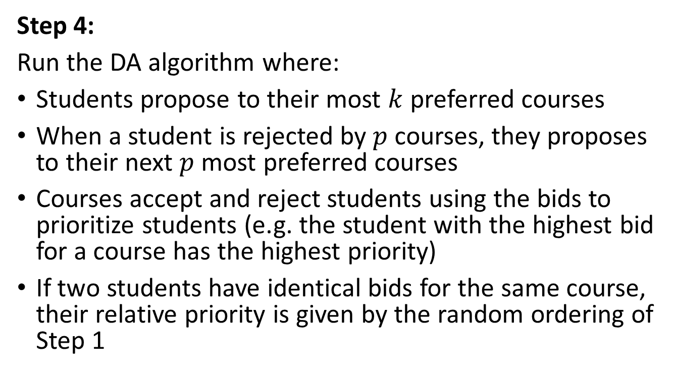
Gale-Shapley Pareto-Dominant Market Mechanism
Step 4:
Run the DA algorithm where:
Students propose to their most $k$ preferred courses
When a student is rejected by $p$ courses, they proposes to their next $p$ most preferred courses
Courses accept and reject students using the bids to prioritize students (e.g. the student with the highest bid for a course has the highest priority)
If two students have identical bids for the same course, their relative priority is given by the random ordering of Step 1

Slide 18
Example
Antonio, Bruno, Camilo, and Dolores need to take two courses (they can up to 2 courses) among courses X, Y, and Z. The capacities are 3, 2, 4, respectively. Each had a budget of 100, and their preferences and bids are (ties are broken randomly):
Preferences
Bids
Antonio | Bruno | Camilo | Dolores
X | X | X | X
Z | Z | Z | Y
Y | Y | Y | Z
Capacity | 3 | 2 | 4
 | X | Y | Z
Antonio | 60 | 38 | 2
Bruno | 48 | 22 | 30
Camilo | 46 | 23 | 31
Dolores | 45 | 35 | 20

Slide 19
Gale-Shapley Pareto-Dominant Market Mechanism
In this mechanism, revealing one’s true preferences over courses in step 2 is a dominant strategy
However, choosing how much to bid in step 3 is still a strategic decision. We need to consider equilibria in the bidding game
Proposition:
With the Gale-Shapley Pareto-Dominant Market Mechanism, if students choose bids that maximize their expected payoffs, then the course assignment (and the prices) correspond to a market equilibrium

Slide 20
Gale-Shapley Pareto-Dominant Market Mechanism
Proposition:
The course assignment obtained using the Gale-Shapley Pareto-Dominant Market Mechanism Pareto dominates the assignment of any competitive equilibrium whenever the bids used constitute an equilibrium
Additionally, it cannot be Pareto dominated by the assignment obtained with the course bidding mechanism (using the same bids)

Slide 21
The Harvard Business School method
Budish and Cantillon (2012) studied the course allocation mechanism used by Harvard Business School.
The mechanism is a variation of the Random Serial Dictatorship
They find that:
  The mechanism is not strategyproof nor efficient
  But it produces outcomes that can be more efficient than a strategyproof mechanism

Slide 22
The HBS Draft Mechanism
Step 1:
Each student submits a preference list over courses
Step 2:
Students are assigned a random number (no two students have the same number)

Slide 23
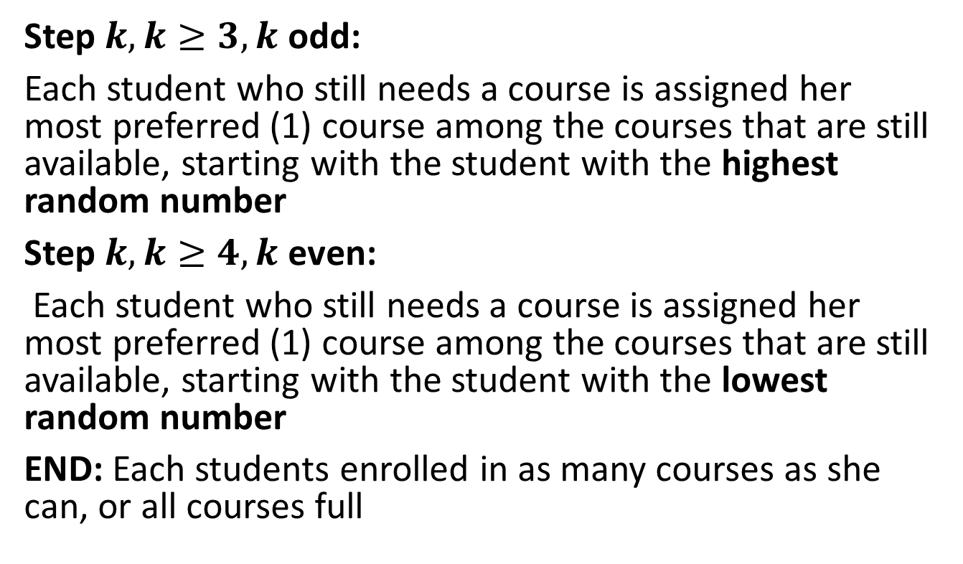
The HBS Draft Mechanism
Step $k,k≥3, k$ odd:
Each student who still needs a course is assigned her most preferred (1) course among the courses that are still available, starting with the student with the highest random number
Step $k, k≥4, k$ even:
Each student who still needs a course is assigned her most preferred (1) course among the courses that are still available, starting with the student with the lowest random number
END: Each students enrolled in as many courses as she can, or all courses full

Slide 24
Example
Suppose that the random order resulting from step 2 is: Alice, Bob, Carol, Denis
The HBS draft mechanism proceeds as follows:
Run serial dictatorship (to choose 1 course) with order: Alice, Bob, Carol, Denis.
Run serial dictatorship (to choose 1 course) with order: Denis, Carol, Bob, Alice
Run serial dictatorship (to choose 1 course) with order: Alice, Bob, Carol, Denis.
Continue until all students have as many courses as they need, or courses are full

Slide 25
Strategic Behavior in HBS Draft
Idea of alternating the order of serial dictatorship is to make it more fair
This does not solve the strategic problem. There is still a conflict between popularity of courses and students’ preferences
Being truthful is not a good strategy if the most preferred course is not popular. Student would be better of by:
  Putting the very popular course as top choice
  Putting the most preferred (and not so popular) course lower in the submitted preferences

Slide 26
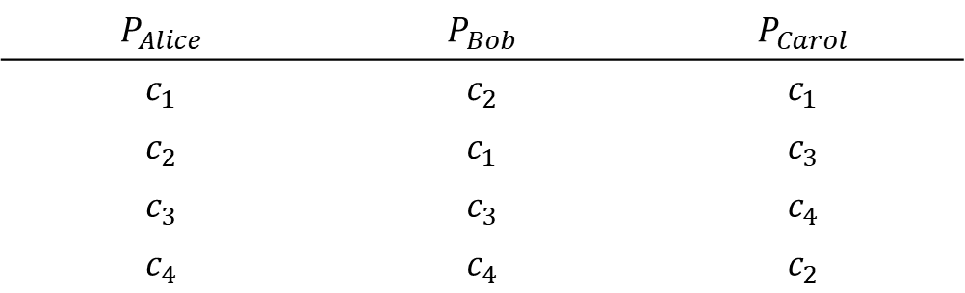
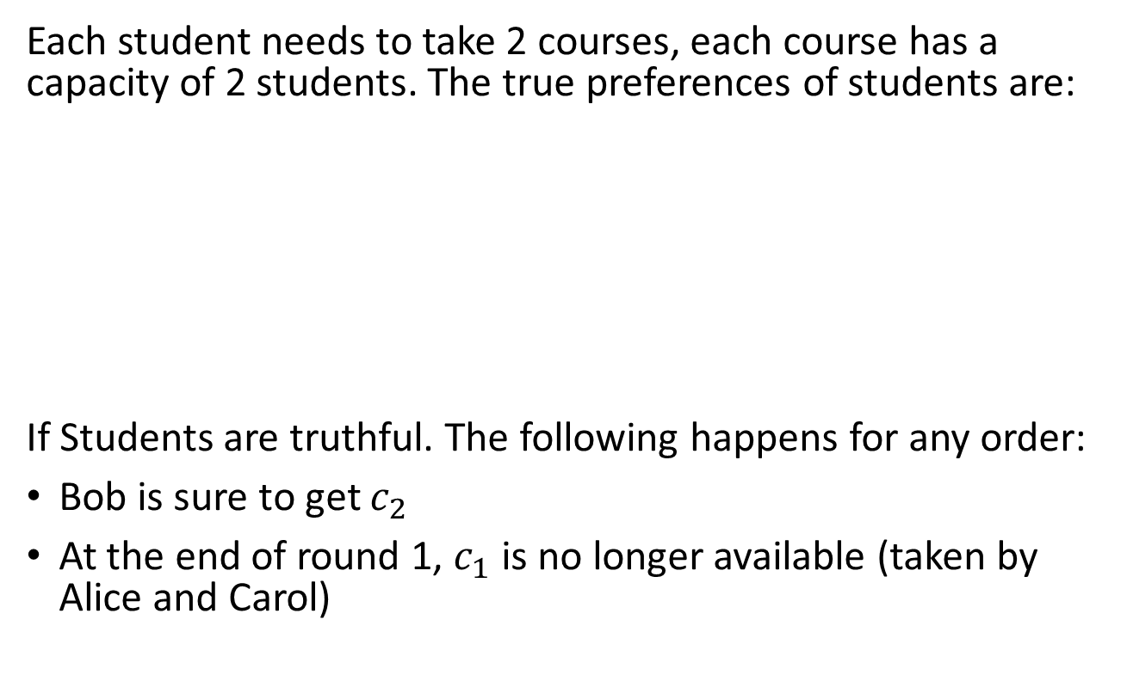
Example
Each student needs to take 2 courses, each course has a capacity of 2 students. The true preferences of students are:
If Students are truthful. The following happens for any order:
Bob is sure to get $c_{2}$
At the end of round 1, $c_{1}$ is no longer available (taken by Alice and Carol)
$$P_{Alice}$$ | $$P_{Bob}$$ | $$P_{Carol}$$
$$c_{1}$$ | $$c_{2}$$ | $$c_{1}$$
$$c_{2}$$ | $$c_{1}$$ | $$c_{3}$$
$$c_{3}$$ | $$c_{3}$$ | $$c_{4}$$
$$c_{4}$$ | $$c_{4}$$ | $$c_{2}$$

Slide 27
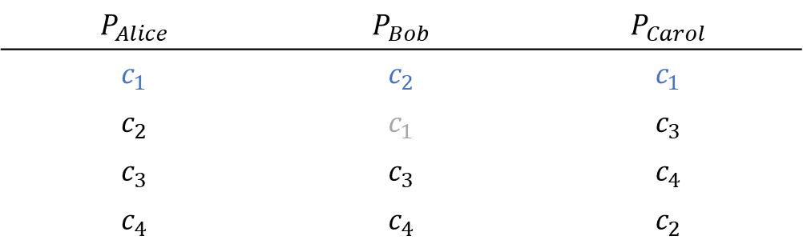
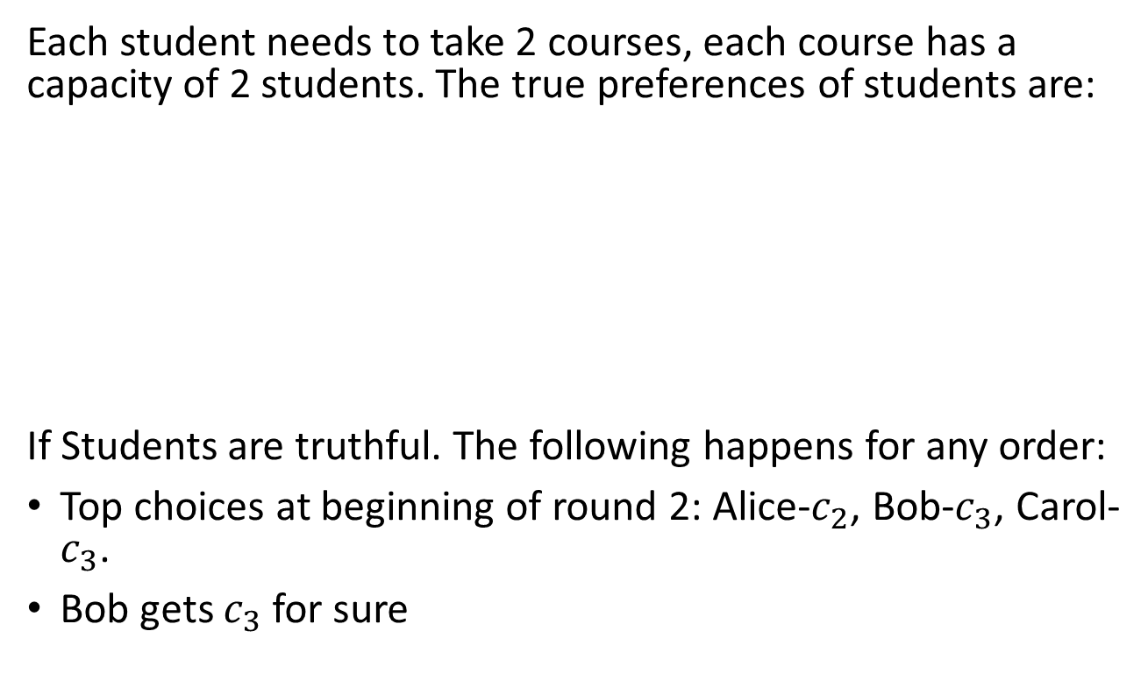
Example
Each student needs to take 2 courses, each course has a capacity of 2 students. The true preferences of students are:
If Students are truthful. The following happens for any order:
Top choices at beginning of round 2: Alice-$c_{2}$, Bob-$c_{3}$, Carol-$c_{3}$.
Bob gets $c_{3}$ for sure
$$P_{Alice}$$ | $$P_{Bob}$$ | $$P_{Carol}$$
$$c_{1}$$ | $$c_{2}$$ | $$c_{1}$$
$$c_{2}$$ | $$c_{1}$$ | $$c_{3}$$
$$c_{3}$$ | $$c_{3}$$ | $$c_{4}$$
$$c_{4}$$ | $$c_{4}$$ | $$c_{2}$$

Slide 28
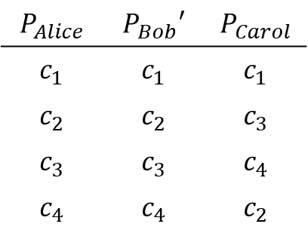
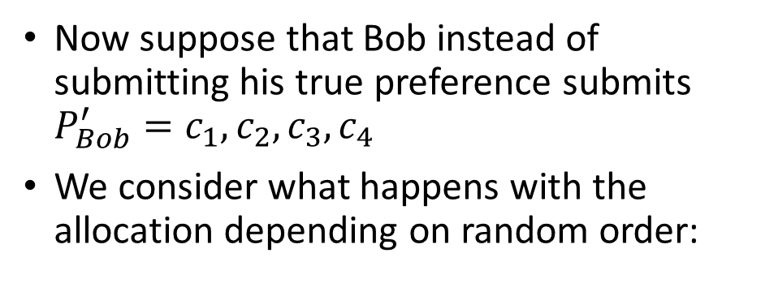
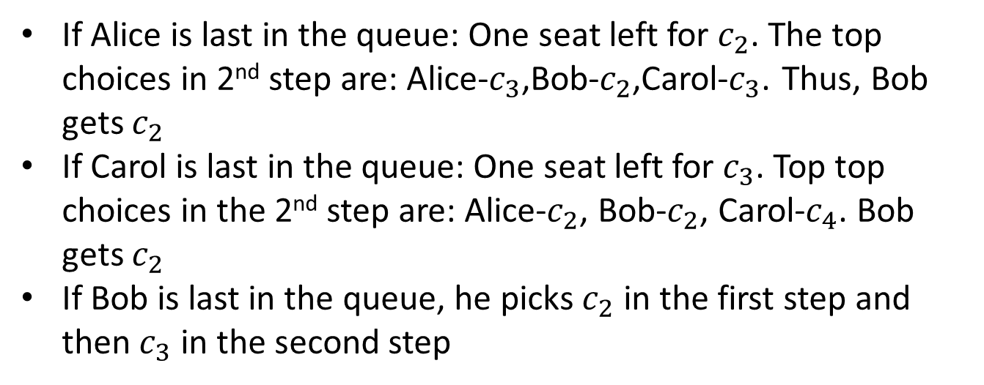
Example
$$P_{Alice}$$ | $$P_{Bob}′$$ | $$P_{Carol}$$
$$c_{1}$$ | $$c_{1}$$ | $$c_{1}$$
$$c_{2}$$ | $$c_{2}$$ | $$c_{3}$$
$$c_{3}$$ | $$c_{3}$$ | $$c_{4}$$
$$c_{4}$$ | $$c_{4}$$ | $$c_{2}$$
Now suppose that Bob instead of submitting his true preference submits $P_{Bob}^{′}=c_{1},c_{2},c_{3},c_{4}$
We consider what happens with the allocation depending on random order:
If Alice is last in the queue: One seat left for $c_{2}$. The top choices in 2nd step are: Alice-$c_{3}$,Bob-$c_{2}$,Carol-$c_{3}$. Thus, Bob gets $c_{2}$
If Carol is last in the queue: One seat left for $c_{3}$. Top top choices in the 2nd step are: Alice-$c_{2}$, Bob-$c_{2}$, Carol-$c_{4}$. Bob gets $c_{2}$
If Bob is last in the queue, he picks $c_{2}$ in the first step and then $c_{3}$ in the second step

Slide 29
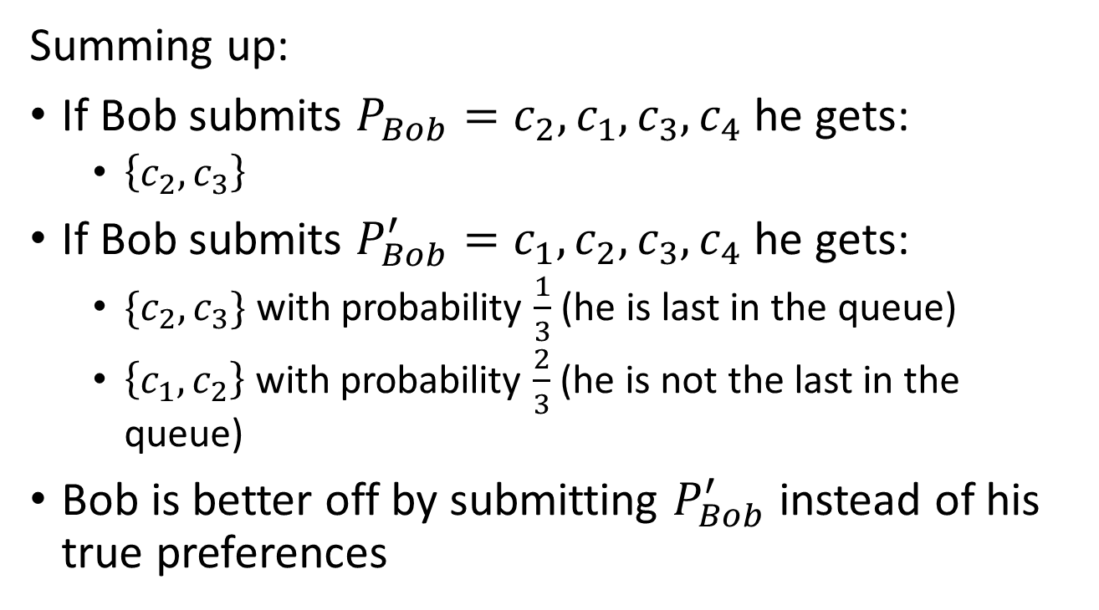
Example
Summing up:
If Bob submits $P_{Bob}=c_{2},c_{1},c_{3},c_{4}$ he gets:
  $\left\{c_{2},c_{3}\right\}$
If Bob submits $P_{Bob}^{′}=c_{1},c_{2},c_{3},c_{4}$ he gets:
  $\{c_{2},c_{3}\}$ with probability $\frac{1}{3}$ (he is last in the queue)
  $\left\{c_{1},c_{2}\right\}$ with probability $\frac{2}{3}$ (he is not the last in the queue)
Bob is better off by submitting $P_{Bob}^{′}$ instead of his true preferences

Slide 30
Analysis of HBS Draft
The HBS Draft is relatively easy to game
If you know which courses are popular (and which aren’t), it is just a matter of re-arranging your ranking to put the popular courses first
But this can have negative consequences:
  If everyone puts the popular courses first (even if they don’t want them as much) it increases congestions and may hurt students that really want the course
Since it is a random mechanism, we can evaluate efficiency ex-ante and ex-post

Slide 31
Analysis of HBS Draft
Budish and Cantillon studied the HBS draft in 2005:
Students should not reverse the relative ranking of two courses in their submitted preference list (w.r.t. their true preferences) if by doing so they do not obtain their preferred course
Students should reverse the relative ranking of two courses if this does not make them loose (i.e. not get) the more preferred course
Notes:
What this is saying is that if a student wants course A and B. His favorite course is A, but B is super popular. The student should not move B up in the preference list if this affects her probabilities of getting course A.

Slide 32
What should students do?
Assuming the following true preferences. If using the HBS Draft, what preference list should each student submit?
Course capacities: X –> 3; Y –> 2; Z –> 4
Antonio | Bruno | Camilo | Dolores
Z | Z | Z | X
Y | Y | Y | Y
X | X | X | Z

Slide 33
Budish and Cantillon
Analyzed data from students who had to submit preference in July 2005:
Conducted a poll in May asking students for their true preferences over courses
Preferences lists submitted for a “trial run” of the enrollment process in May 2005
Obtained the preferences submitted in the real enrollment process in July 2005

Slide 34
Budish and Cantillon
They found several patterns in the data:
True preference revealed in May differed substantially from preferences lists submitted in May and July
Changes between the true preferences and the submitted preferences follow the logic of their previous theoretical propositions
It appears that in the HBS Draft mechanism it is relatively easy to undertake strategic misrepresentations

Slide 35
Budish and Cantillon
The preferences students submitted in July made them end up worse off than what would have happened if they all submitted their true preferences
Two sources of inefficiencies:
  Strategic behavior of students: Overcrowding of popular courses (make them appear more popular), and ignoring courses they truly prefer
  Mechanism itself is not efficient
  Inefficient = Some students would gain from trading courses they got between themselves

Slide 36
Budish and Cantillon
Using the true preferences, they ran simulations:
On average, 64% of students would benefit by trading at least one of the courses obtained with the HBS Draft mechanism
Under the HBS Draft mechanism, strategic play lowers students’ welfare compared to truthful play.
  It reduced the number of students getting their top choice (from 82% to 63%)
What if we used a strategyproof mechanism to fix this? Would it be better for students?
  It didn’t work out. They tried a serial dictatorship w/students choosing full schedules and students were assigned to even less preferred courses

Slide 37
Course assignment at Wharton
The mechanisms we have discussed so far implicitly assume that students’ preferences over courses are responsive
But students may well consider some courses as substitutable or complementary
Ideally, we would like a combinatorial assignment mechanism. But:
  In general, it is not possible to have a robust mechanism unless we use the serial dictatorship
  Asking students preferences over schedules is not practical

Slide 38
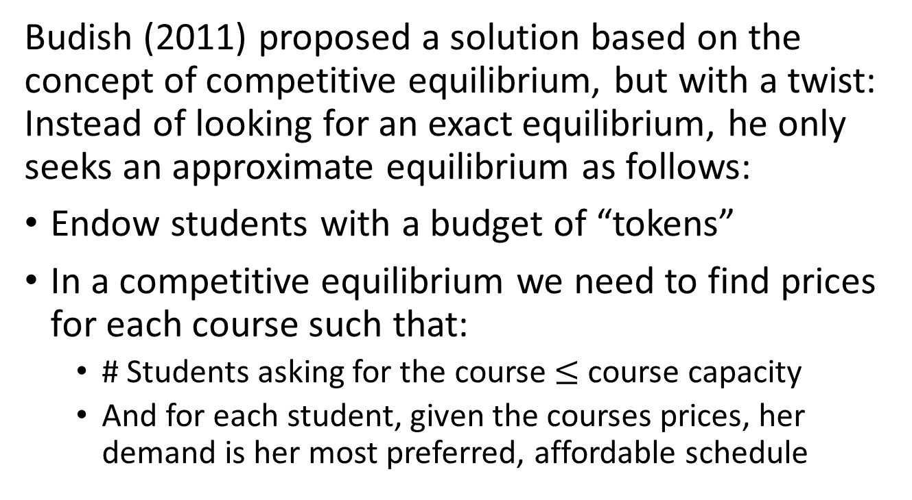
Approximate Competitive Equilibrium from Equal Incomes
Budish (2011) proposed a solution based on the concept of competitive equilibrium, but with a twist: Instead of looking for an exact equilibrium, he only seeks an approximate equilibrium as follows:
Endow students with a budget of “tokens”
In a competitive equilibrium we need to find prices for each course such that:
  # Students asking for the course $≤$ course capacity
  And for each student, given the courses prices, her demand is her most preferred, affordable schedule

Slide 39
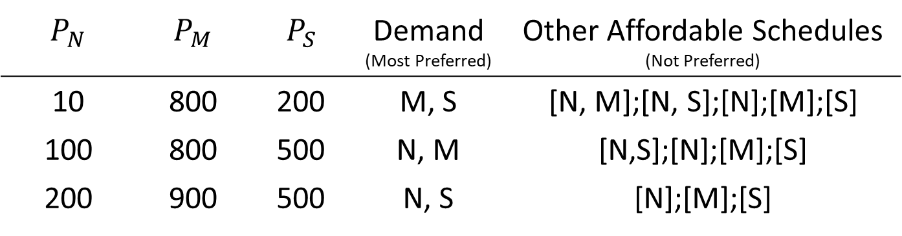
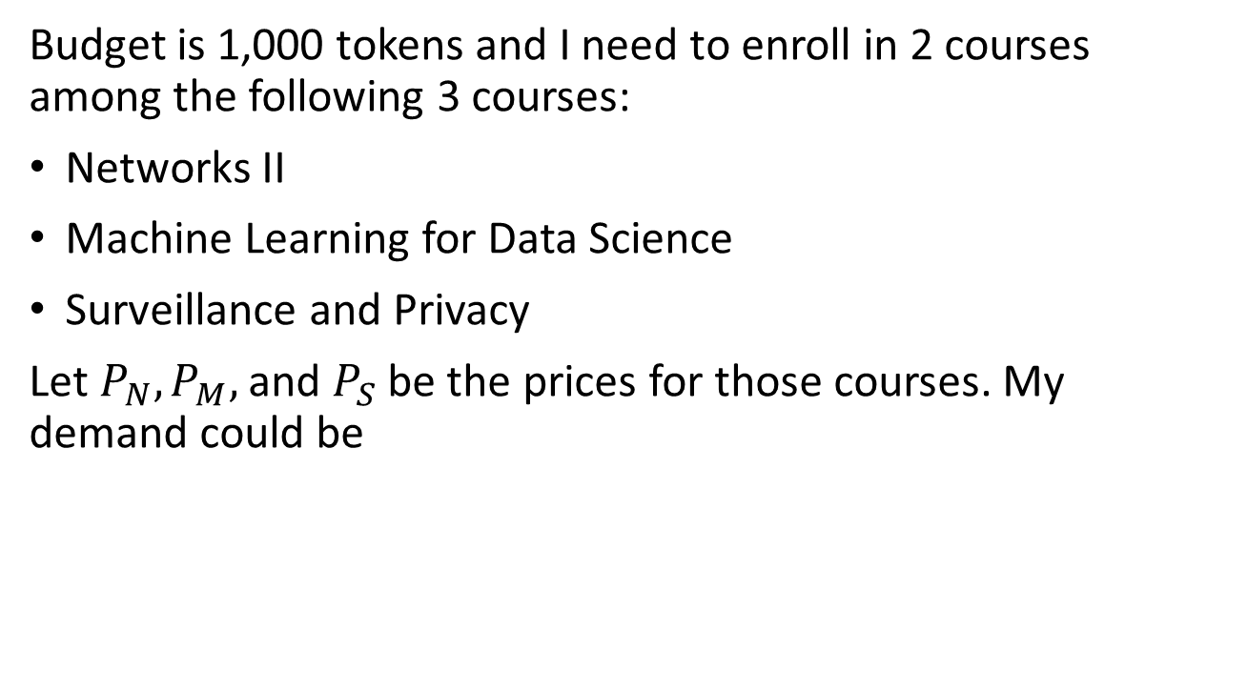
Example
Budget is 1,000 tokens and I need to enroll in 2 courses among the following 3 courses:
Networks II
Machine Learning for Data Science
Surveillance and Privacy
Let $P_{N}, P_{M},$ and $P_{S}$ be the prices for those courses. My demand could be
$$P_{N}$$ | $$P_{M}$$ | $$P_{S}$$ | Demand (Most Preferred) | Other Affordable Schedules (Not Preferred)
10 | 800 | 200 | M, S | [N, M];[N, S];[N];[M];[S]
100 | 800 | 500 | N, M | [N,S];[N];[M];[S]
200 | 900 | 500 | N, S | [N];[M];[S]

Slide 40
Approximate Competitive Equilibrium with Equal Incomes (ACEEI)
Approximate equilibrium: Prices do not need to clear the markets
  For instance, the prices could be that there are some courses that are oversubscribed
  For HBS, he calculates that with 900 students choosing 5 courses (out of 50), there are only 11 instances of oversubscription
Not all students are endowed with the same budget, but difference can be very small:
  At Wharton the average budget is 5,000 tokens, the maximum difference between 2 budgets is 80 tokens

Slide 41
Approximate Competitive Equilibrium with Equal Incomes (ACEEI)
Budish’s approximate competitive equilibrium works well in theory, but may be difficult to implement
In 2011-2012 the Wharton School considered changing its course assignment mechanism
Asking students their demands is impossible: The number of possible schedules is over 100 million

Slide 42
Reporting Complex Demands:
Experimental Design
To test whether the ACEEI could be implemented, Budish and Kessler set up an experiment
Students give a score between 1 and 100 for any course they are interested in (1 least desired, 100 most desired)
Students can report adjustments for any pair of courses:
  A positive adjustment for courses X and Y: Signals they are viewed as complements
  A negative adjustment for courses X and Y: Signals they are viewed as substitutes
For each schedule: Add the score of each course (and adjustments, if any). The preferences over schedules is given by the ranking of their total scores

Slide 43
Example
A student reports the following scores:
Additionally, she reports the following adjustments:
  A & C: -25
  B & D: +25
Based on the scores and adjustments, determined the ranking of schedules for this student:
    A&B = 90 + 50 = 140
    A&C = 90 + 40 – 25 = 105
    B&C = 50+40 = 90
    B&D = 50+20 = 50 + 20 + 25 = 95…
    Most preferred schedule is the one with the highest score
Course | A | B | C | D
Score | 90 | 50 | 40 | 20

Slide 44
Experimental Design
Participants were then given what the computer found as being their 10 most preferred schedules
  Allows participants to fine tune their preferences
Once the scoring of each course (and the adjustments) is finalized, a heavy computation is made to calculate the ACEEI

Slide 45
Results
The experiment was successful. Wharton adopted the mechanism in Fall 2013
In the experiments, participants were also asked to play with the former bidding mechanism, and then to compare the outcomes of each mechanism
  Reporting preferences over combinations of courses is hard
  Comparing two schedules and say which one you prefer is easy
Students were also asked to compare their schedule with that of other students (to look for envy)

Slide 46
Results
8 sessions were run:
For 6 sessions, the majority of students preferred the schedule obtained with ACEEI. For 2 it was a tie
Envy is almost impossible to eliminate in problems like course allocation
  But, ACEEI reduced envyness by ~30%
The scoring methodology allows reporting preferences over schedules accurately:
  When asking students to compare schedules, 85% of the comparisons were consistent with the predicted preferences (i.e. what you would infer from the scores)

Slide 47
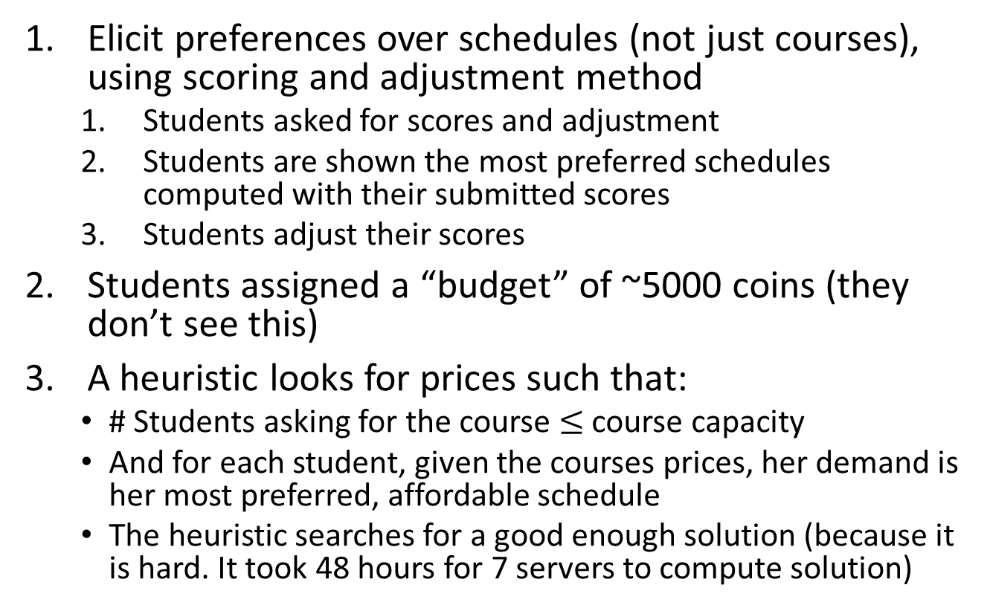
Summary ACEEI
Elicit preferences over schedules (not just courses), using scoring and adjustment method
  Students asked for scores and adjustment
  Students are shown the most preferred schedules computed with their submitted scores
  Students adjust their scores
Students assigned a “budget” of ~5000 coins (they don’t see this)
A heuristic looks for prices such that:
  # Students asking for the course $≤$ course capacity
  And for each student, given the courses prices, her demand is her most preferred, affordable schedule
  The heuristic searches for a good enough solution (because it is hard. It took 48 hours for 7 servers to compute solution)

Slide 48
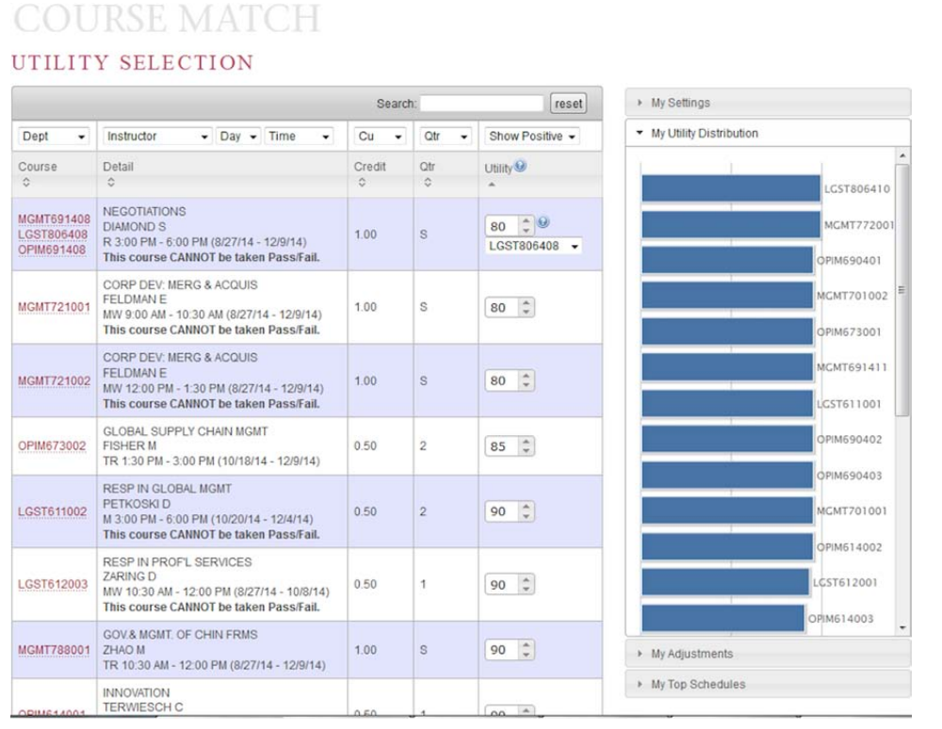
Wharton Mechanism – Preference Elicitation: Entering Utilities
From: Budish et al. 2017. Course Match: A Large-Scale Implementation of Approximate Competitive Equilibrium from Equal Incomes for Combinatorial Allocation.

Slide 49
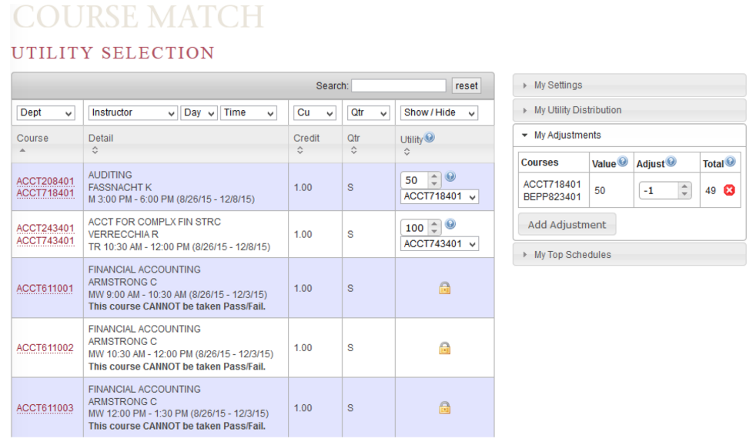
Wharton Mechanism – Preference Elicitation: Entering adjustments
From: Budish et al. 2017. Course Match: A Large-Scale Implementation of Approximate Competitive Equilibrium from Equal Incomes for Combinatorial Allocation.

Slide 50
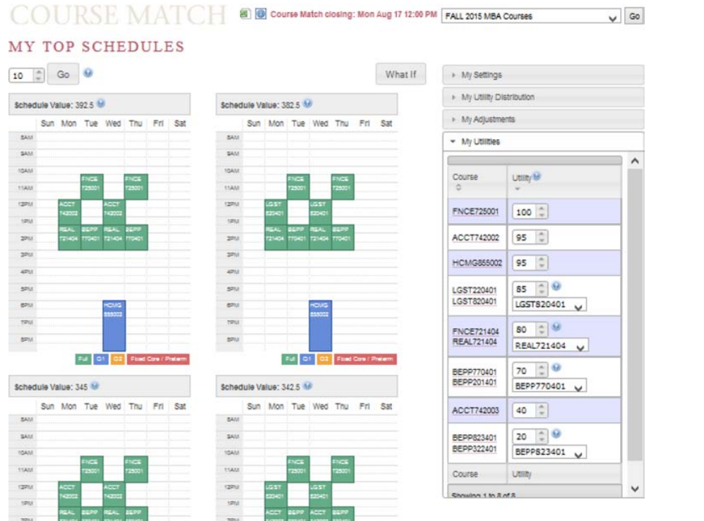
Wharton Mechanism – Preference Elicitation: Fine Tuning Schedules
From: Budish et al. 2017. Course Match: A Large-Scale Implementation of Approximate Competitive Equilibrium from Equal Incomes for Combinatorial Allocation.

Slide 51
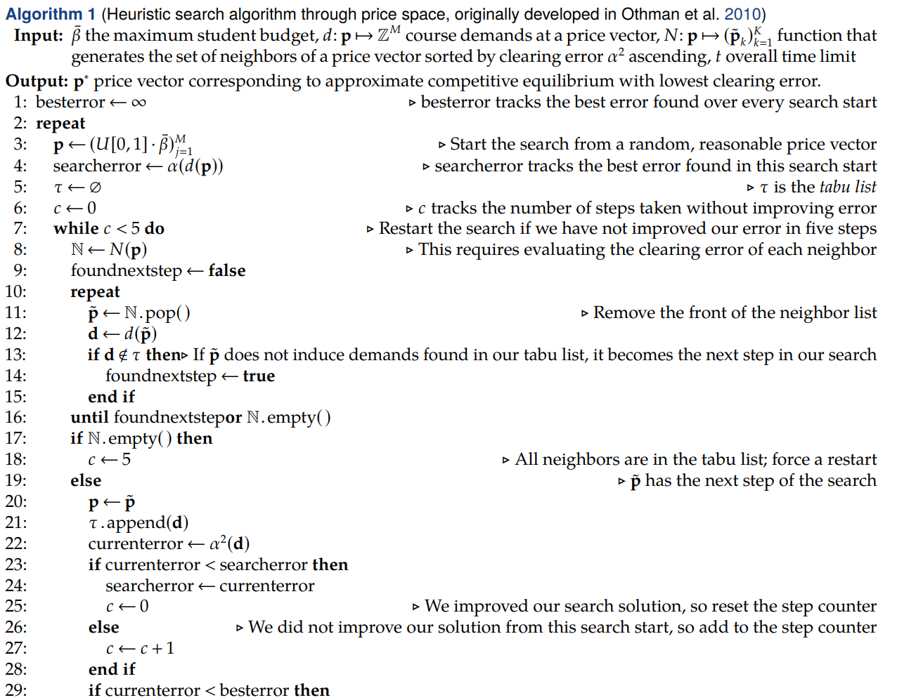
Wharton Mechanism – Heuristic to find course prices
From: Budish et al. 2017. Course Match: A Large-Scale Implementation of Approximate Competitive Equilibrium from Equal Incomes for Combinatorial Allocation.

Slide 52
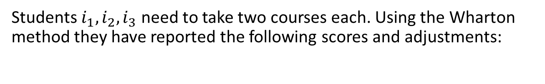
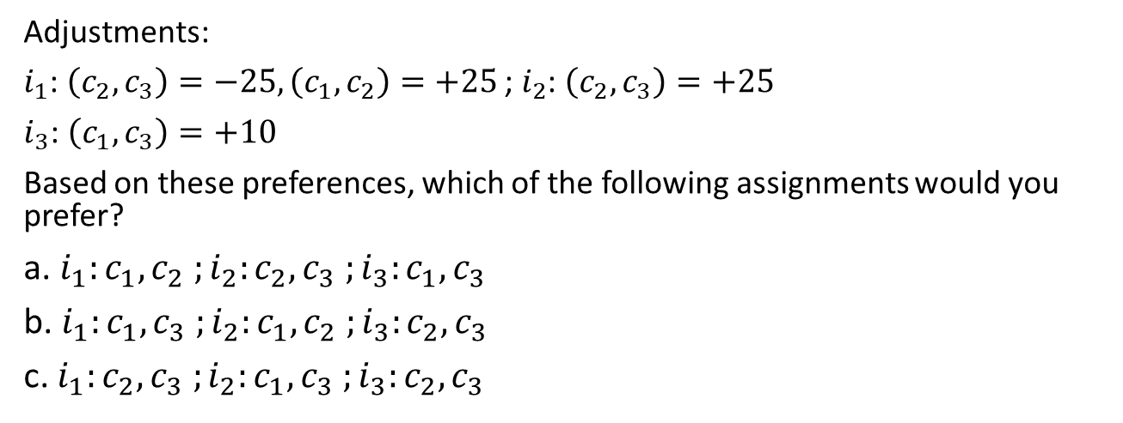
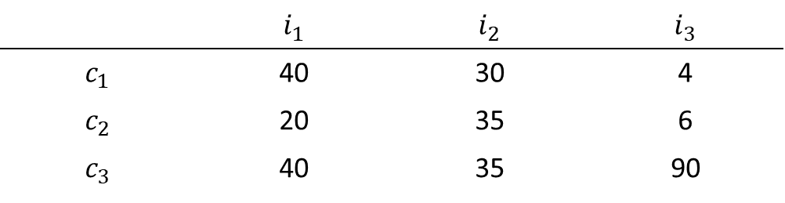
Quiz Question
Students $i_{1},i_{2},i_{3}$ need to take two courses each. Using the Wharton method they have reported the following scores and adjustments:
 | $$i_{1}$$ | $$i_{2}$$ | $$i_{3}$$
$$c_{1}$$ | 40 | 30 | 4
$$c_{2}$$ | 20 | 35 | 6
$$c_{3}$$ | 40 | 35 | 90
Adjustments:
$i_{1}$: $\left(c_{2},c_{3}\right)=−25, \left(c_{1},c_{2}\right)=+25$ ;$i_{2}$: $\left(c_{2},c_{3}\right)=+25$
$i_{3}$: $\left(c_{1},c_{3}\right)=+10$
Based on these preferences, which of the following assignments would you prefer?
a. $i_{1}:c_{1},c_{2} ;i_{2}:c_{2},c_{3} ;i_{3}:c_{1},c_{3}$
b. $i_{1}:c_{1},c_{3} ;i_{2}:c_{1},c_{2} ;i_{3}:c_{2},c_{3}$
c. $i_{1}:c_{2},c_{3} ;i_{2}:c_{1},c_{3} ;i_{3}:c_{2},c_{3}$

Slide 53
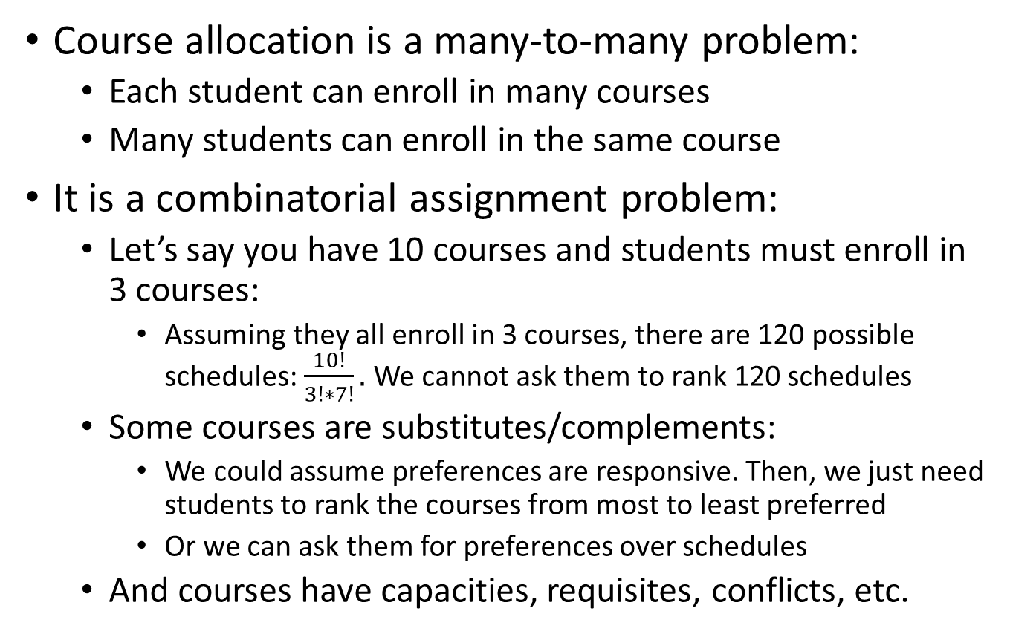
Summary / Take Away
Course allocation is a many-to-many problem:
  Each student can enroll in many courses
  Many students can enroll in the same course
It is a combinatorial assignment problem:
  Let’s say you have 10 courses and students must enroll in 3 courses:
    Assuming they all enroll in 3 courses, there are 120 possible schedules: $\frac{10!}{3!∗7!}.$ We cannot ask them to rank 120 schedules
  Some courses are substitutes/complements:
    We could assume preferences are responsive. Then, we just need students to rank the courses from most to least preferred
    Or we can ask them for preferences over schedules
  And courses have capacities, requisites, conflicts, etc.

Slide 54
Summary / Take Away
There is a simple mechanism that is strategyproof, non-bossy, and pareto efficient: The serial dictatorship
  Draw a random order of students. Use the order to let students select “full schedules”
  Does not work well in practice – serious fairness issues
Auctions are often used to allocate courses:
  Students are endowed with a budget (tokens, points, etc)
  Students bid for courses
    Serial dictatorship is run in which students choose one course at a time (the one they bid for) from highest to lowest bid
  This is not strategyproof, and bids cannot be interpreted as market-clearing prices. Not efficient, not fair

Slide 55
Summary / Take Away
Possible solution is to do a mix (Gale-Shapley Pareto Dominant Market Mechanism):
  Ask for both preferences and bids
    Use preferences to run D.A. algorithm (students propose to courses in order of their preferences
    Bids are used to determine students’ priority for each course
  But it is not strategyproof: It is in the reporting of preferences is it, but not in the bidding
  If students submit bids that maximize their expected payoffs, then the resulting course assignment is a market equilibrium, course prices correspond to market prices, and the mechanism is efficient

Slide 56
Summary / Take Away
HBS Draft: Series of serial dictatorship where students choose one course at a time, and the order of dictators is reversed in each step:
  Not strategyproof, not efficient
  Simple to strategize: Rank first popular course (and students in fact do behave in this way)
  It increases welfare compared to a strategyproof mechanism, even with strategic playing
    Fairness is improved with respect to serial dictatorship, but efficiency is lost
    Strategic play leads to worst outcome compared to what would happen if everyone reported truthful preferences

Slide 57
Summary / Take Away
Wharton put in place a mechanism that allows students to express substitutability and complementarity (By Budish and Kessler)
Students’ preferences are elicited, then heavy computation determines students’ demand (with a budget constraint) and calculates prices that would lead to an approximate competitive market equilibrium
The equilibrium is approximate, and students have unequal budgets (but differences are really small)
Outcomes under Wharton mechanism is preferred by students to the traditional bidding mechanism
Outcome is very close to being efficient and fair

